Slide 1


AIRLINE RELIABILITY
DATA PIPELINE
From raw flight operations data to reliable airline, airport and route insights
Peter Blechert · Data Engineering · 04.09.2026

Slide 2
ABOUT ME & PRESENTATION FOCUS
01
PERSONAL CONTEXT
PRESENTATION QUESTION
• Data Engineering final project
• Focus: realistic, complete pipeline
• 25+ years of database experience
• Career direction: Data Engineering
• Degree: Dipl.-Kfm. (FH)
• Preferred regions: NRW / Hamburg / Schleswig-Holstein · Remote
• Contact: peter.blechert@web.de
How can monthly raw data become a reliable data product?
The next 15 minutes show the problem, the engineering solution, and the proof that it works.
2 / 13

Slide 3
MOTIVATION & GOALS - TWO PERSPECTIVES
02
My Goal
Stakeholder: Corporate Travel / Travel Ops. Manager - Goal
Build a small but complete production-like pipeline.
Get trusted, comparable reliability information.
real external source
monthly ingestion and partitioning
Bronze / Silver / Gold layers
Data Quality
Database model
Orchestration
Data consumption through dashboard
• Which airlines are reliable?
• Which airports concentrate problems?
• Which routes are operationally robust?
3 / 13

Slide 4
STAKEHOLDER & DECISION DIMENSIONS
03
Why this stakeholder? The result supports decisions across airline, airport and route reliability - without needing raw files.
Stakeholder: Corporate Travel / Travel Operations Manager
AIRLINES
AIRPORTS
ROUTES
Which carriers operate most reliably?
Where are disruptions concentrated?
Which connections are robust?
carrier selection / benchmarking
connection and disruption risk
route selection / reliability comparison
Core idea: one data product can serve several decision perspectives.
4 / 13

Slide 5
DATA SOURCE & DATA PROBLEM
04
Source: BTS -Bureau of Transportation Statistics (monthly On-Time Performance data)
https://www.transtats.bts.gov/
607,577
12
351
6,131
flight records · June 2026
airlines
airports
routes
WHAT THE SOURCE CONTAINS
WHAT IT DOESN'T
• Flight date, airline, origin and destination airport
• planned and actual times
• delays, cancellations, diversions
• delay causes and reference data
• quality boundary
• standardized schema
• analytical model
• business-ready reliability metrics
• reproducible monthly processing
5 / 13

Slide 6
ENGINEERING QUESTION & ARCHITECTURE
05
How can monthly flight data be transformed into a reliable, reproducible analytics data product?
BTS
BRONZE
SILVER
POSTGRESQL
GOLD
STREAMLIT
source
→
preserve raw
→
validate
→
database model
→
metrics
→
consume
ZIP / CSV
ZIP / CSV
validated Parquet
Facts & Dimensions
Reliability Marts
Interactive Dashboard
Airflow orchestrates the process · Docker provides the reproducible runtime
The architecture is not a tool list - each layer answers a concrete requirement.
6 / 13

Slide 7
INGESTION & BRONZE - PRESERVE THE SOURCE
06
INGESTION
BRONZE
• monthly available ZIP / CSV files
• reference files for airlines and airports
• routes derived from flights
• download only when missing
• year/month partitioning
• traceability to source
• repeatable monthly loads
• clean separation from transformation logic
Raw ZIP / CSV remains unchanged.
Purpose: make the source reproducible before any analytical transformation happens.
7 / 13

Slide 8
SILVER & DATA QUALITY — CREATE TRUST
07
Silver is the quality boundary of the pipeline - not just another file format.
Schema
Types
Domain
required fields
date and numeric standardisation
airport code and route validation
Flags
Plausibility
cancelled, diverted, delay flags
distance and elapsed time
Result: standardized Parquet data that can safely enter the analytical model.
Parquet is a column-oriented format for efficient storage and fast analytical queries.
8 / 13

Slide 9
DATA MODEL & GOLD MARTS
08
dim_date
Gold Airline Reliability
dim_airline
fact_flight
Gold Airport Reliability
dim_airport
Gold Route Reliability
The star-schema model separates operational detail from business-level reliability metrics.
9 / 13

Slide 10
AIRFLOW - FROM SCRIPTS TO PIPELINE
09
A pipeline is more than a sequence of scripts.
Scheduling
Dependencies
Retries
monthly runs
correct task order
temporary failures
Failure handling
Quality checks
Notification
stop downstream tasks
prevent bad data propagation
Alert via emails on errors
▶ LIVE DEMO - AIRFLOW
Show DAG → task dependencies → retry / recovery → simulated failure
10 / 13

Slide 11
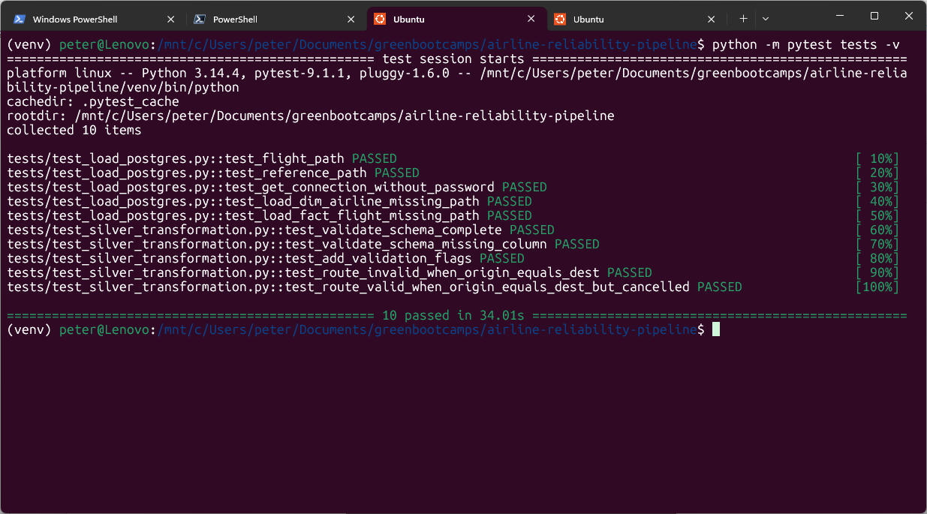
AUTOMATED TESTING – WHEN & WHY
10
Pytest validates critical code logic independently from the monthly Airflow data run.
WHAT IS TESTED?
• schema validation
• data-quality rules & route logic
• Silver flight & reference path handling
• controlled failure behaviour
WHEN SHOULD TESTS BE RUN?
• after changes to transformation or loading code
• before commit / release / presentation
• After dependency or environment changes
• Not simply because a new month arrives
Monthly Airflow quality checks validate new data – pytest validates the code when the code changes.
Current setup: pytest is started manually - it is not part of the Airflow DAG.
11 / 13

Slide 12
CONSUMPTION LAYER - RELIABILITY DASHBOARD
11
The Gold layer becomes an interactive decision layer - without exposing pipeline complexity.
AIRLINES
AIRPORTS
ROUTES
KPI comparison and development over time
departure & arrival reliability
with KPI and map
comparison, map and specific-route analysis
▶ OPEN LIVE DASHBOARD
Live demo: Airlines → Airports → Routes - selected interactions only
12 / 13

Slide 13
RESULTS & OUTLOOK
12
STAKEHOLDER VALUE & RECOMENDATIONS
NEXT EVOLUTION
• reliable monthly KPI basis
• airline, airport and route comparison
• identify areas for deeper analysis
• support decisions - not replace them
• why did delays happen?
• monitoring and alerting
• cloud deployment / managed storage
• delay and cancellation risk prediction
Descriptive → Diagnostic → Predictive
Reliable decisions require reliable data!
13 / 13

